Slide 1
ICHRA Solution for

Slide 2
Personalized Benefits for the Modern Workplace
A New Way to Offer Benefits to Your Employees
At benefitbay, we are committed to unlocking the power of personalized benefits for our customers.
We believe that by empowering employers to leverage Individual Coverage Health Reimbursement Arrangements (ICHRA) we can help put the employee back at the center of your employee benefits package.
With security top-of-mind benefitbay protects your employee data with the industry’s only SOC II complaint system. HIPPA and ERISA compliance is important to you, to your employees so we ensure it is important to us. We’ve got your data protected inside the benefitbay ICHRA experience.
We are proud to partner with your Insurance Agent to help unlock personalized benefits for your population. Welcome to ICHRA, done right!
ICHRA provides a more logical solution, where employers provide a “defined contribution” and enable employees to shop for a plan that meets their family’s specific requirements.

Slide 3
Why ICHRA?
Employer Advantages
Gets you out of the insurance business
No more guessing what plan best meets your diverse employee population
Can still offer a group health plan to a class of employees and an ICHRA to a class of employees
You determine how much you want to contribute by class and by age
Fixed, predictable costs, year after year
FICA savings for employee’s portion of premium
No minimum participation or contribution requirements
No open enrollment process
Less administration
Less compliance
Employee Advantages
More plan choices, selected by employee to best fit their family needs
Employer contribution towards premium is tax-free
Plan moves from job to job – survives employment
Savings and potential government subsidies*

Slide 4
Attributes of an ICHRA:
Employers provide pre-tax dollars to employees to buy individual medical coverage.
No limit on the employer contribution.
Works for large groups (50+) and small groups (50 and under).
ICHRAs meet large group ACA mandates.
Small groups can leverage ACA subsidies.
Employers can replace group health plans for the whole company, or just a segment of employees.

Slide 5
Affordability
The Employer Mandate through the Affordable Care Act (ACA) requires that employers over 50 full-time equivalent (FTE) employees offer health insurance to their employees. Employers over 50 who do not offer health insurance coverage to their employees are subject to large penalties.
An ICHRA plan can satisfy the Employer Mandate as long as it is designed to be “affordable”. The IRS definition of affordability with an ICHRA plan is:
An ICHRA is affordable if the remaining amount an employee has to pay for a self-only silver plan on the exchange is less than 9.12% of the employee’s household income (as of 2023).

Slide 6
Premium Tax Credits
With benefitbay’s Subsidy Advantage tool you can review the best path to setting your ICHRA contribution.
Small employers that are not subject to the Employer Mandate may choose to either offer an “affordable” ICHRA plan, or an “unaffordable” ICHRA plan.
This is where tax credits for employees could come into play. If the ICHRA is considered affordable, then employees are not eligible for tax credits.
If the ICHRA is unaffordable, then employees can choose between tax credits or the ICHRA. In some cases, employers may want to offer an unaffordable ICHRA plan so that their employees can receive tax credits.

Slide 7
Employee Class Options
There are 11 IRS defined employee classes. These may be combined to further define a segment of employees.
Full-time Employees
Part-time Employees
Seasonal Employees
Employees covered by a collective bargaining agreement
Employees who have not satisfied a waiting period for coverage
Non-resident aliens with no US-based income
Employees whose primary site of employment is in the same rating area
Salaried Employees
Non-Salaried Employees
Temporary Employees of a staffing firm
A combination of two or more of the above classes.

Slide 8
Individual Market Enrollments
Enrollment Period
Qualifying Events
To enroll in an individual health plan, it must be within the National Open Enrollment period which typically runs from November to December.
Outside of Open Enrollment, a qualifying event must be triggered in order to purchase a plan (i.e., the birth of a child, a marriage, a divorce or moving.)
ICHRA Enrollment
Calendar Year
When an employer decides to offer an ICHRA, it triggers a special enrollment period which gives employees 60 days to purchase a health plan. This allows an employer to offer an ICHRA anytime during the year.
ICHRA’s run on a calendar year so, if an ICHRA starts anytime after January 1, there will be a short plan year and start over the following January 1.

Slide 9
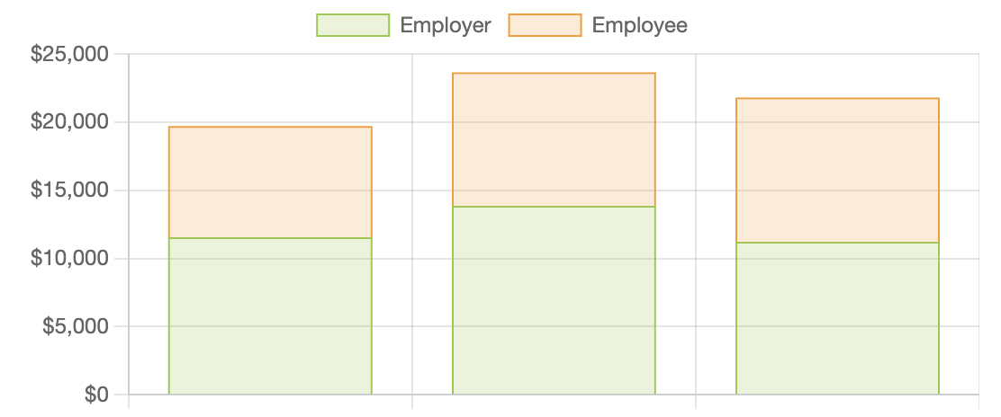
Premium Cost Analysis
Moving to a personalized benefit experience offers your employees the power of choice and helps you maximize the value of your employee benefits program. Employees will elect a personal policy from a variety of options based on their location.
For the analysis below we are comparing all currently enrolled members on a Gold level personalized plan. This total cost analysis is designed to provide a foundation for defining if ICHRA is a good-fit option for you, your budget and your 22 employees.
Current Medical Premiums
Renewal Medical Premiums
Gold Individual Medical Premiums

Slide 10
Executive Summary
Classes
Hourly & Salary
10- year age bands
Total Number Enrolled:
EEO: 109
EES: 31
EEC: 11
EEF: 15
PT: 43
ER Contributions
Classing Options by:
Hourly / Salary
Location
Full Time / Part Time
Client Fees included in ICHRA ER number above – Invoiced monthly
$200 Annual fee + $15 per enrolled per month + Broker’s fees

Slide 11
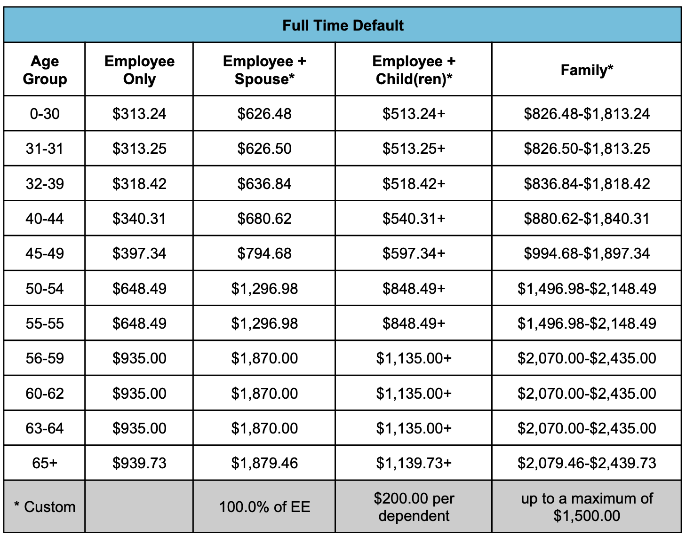
Sample Employer Contribution Funding by Class Type and Age Bands

Slide 12
benefitbay Provides:
1
Plan design analysis
Class and contribution structure
Subsidy eligibility for small employers
ACA compliance for Applicable Large Employers
Employer Experience
Employee Experience
Employee communication campaign templates
Advanced Reimbursement Checking (ARC)
Online Enrollment
Live
Chat
Self-guided
Payroll Deduction Report
Summary Plan Description
1095 data
Employer Engagement team and User support team
2
3
4
5
6
7
8
9
10

Slide 13
Banking & Compliance
Advanced Reimbursement Checking accounts are established for each employee.
These accounts are set for automatic payment, pre-funded with the total monthly premium.
Prior to Open Enrollment Employer Account will need to be funded. We will determine the amount based on the census provided.
Employee’s share of the premium is payroll deducted.
This unique funding arrangement feels much like the group health plan model.
Sample IRS notice provided
System generated Summary Plan Description
1095 data provided to Applicable Large Employers
Update your COBRA administrator ICHRA is being offered
Compliance

Slide 14
Employer Experience
1
Determine the HRA eligibility and contribution strategy with the benefitbay real-time modeling tools. Provides real-time, interactive visibility to various available options to meet their goals.
Employer funds the ICHRA account each month with funds for employees to pay their entire upfront premium through benefitbay’s Advanced Reimbursement Checking (ARC) system.
Employees shop the personalized market through benefitbay’s shopping and enrollment partners and enroll in plans that are the best fit.
Employees pay with the ARC account number provided by benefitbay and have no out-of-pocket expenses. No need to submit a claim for reimbursement.
Benefitbay does monthly reconciliation of HRA and proof of coverage on employer and employee’s behalf. No need for employee to submit monthly attestation.
Employer runs the payroll deduction report from their benefitbay home to capture any premium above the contribution amount.
Employer maintains current employee population adding new hires and terminations in their employer home.
2
3
4
5
6
7

Slide 15
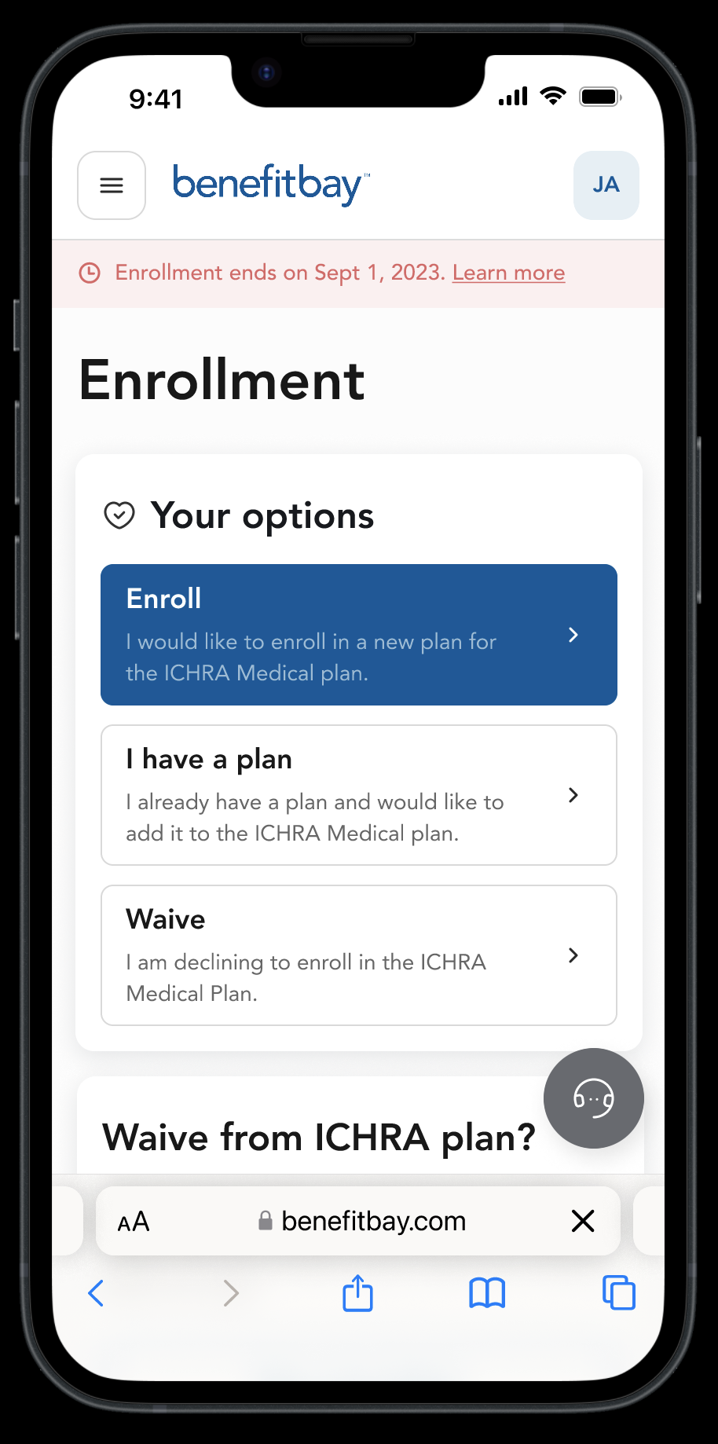
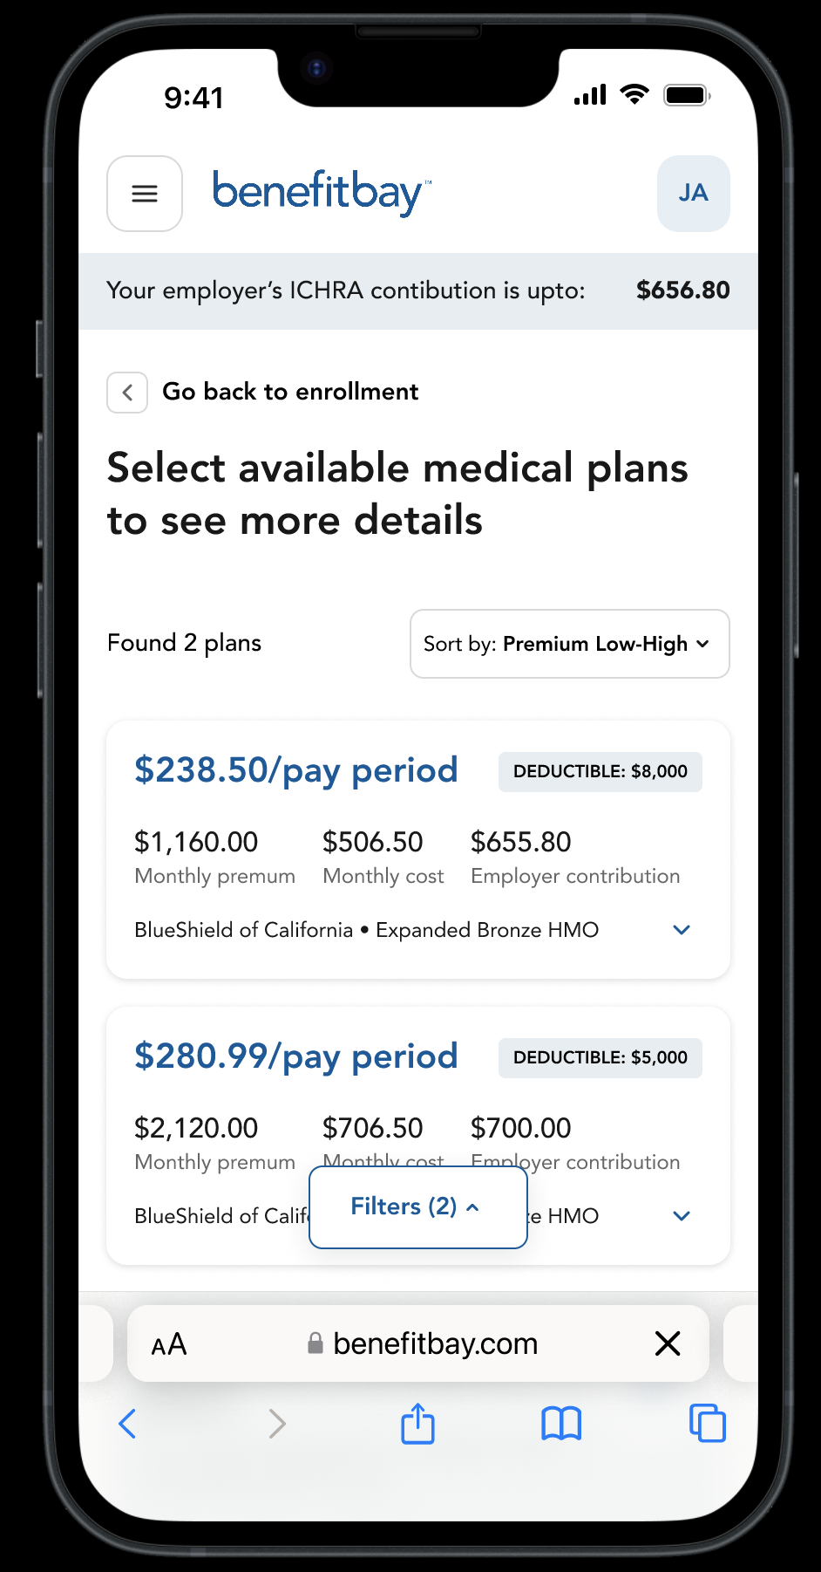
Employee Experience
Benefitbay offers the best employee experience in the industry!
No monthly claims to submit
No attestation requirements
No need to wait for a reimbursement
3 Easy Steps to Get Started:
Enroll
Verify & Update Profile Info
Select a Plan or Waive Coverage
Licensed Enrollment counselors available to support employees with plan selections.
Pay
Use employer provided banking
account to pay for coverage monthly.
Employee portion of the premium will
be payroll deducted.
Enjoy
Set-up account with carrier through benefitbay’s employee home to manage billing process and receives Explanation of Benefits for your medical care received.

Slide 16
ICHRA Costs
1
$250 Annual Plan Document Setup Fee
Each year affordability testing and compliance will be reviewed, and you have the chance to make updates to your ICHRA contribution. After the annual compliance review you will receive a new calendar year ICHRA plan document.
$20 Per Enrolled Per Month (PEPM) Minimum $200 Monthly Administration Costs
Benefitbay will provide the monthly system access, software updates, employee and employer experience for the ICHRA solutions based on the actively enrolled employee count. This includes unlimited access to the ARC accounts, employer visibility into carrier payments made, benefitbay support and success services to ensure you have a great ICHRA experience.
$20 PEPM Agency Consulting Fee
Benefitbay will provide a consolidated Invoice for both the benefitbay administrative costs and your Agent's consulting fee. These fees are billed monthly based on the Actively enrolled employee count as-of the first of the month.
2
3

